Slide 1
Module 1: Microservices

Slide 2
Agenda
Why Cloud Apps?
Handling Failure
Regions, availability zones & fault domains
Distributed Cloud Apps - Microservices
Reasons to split monolithic app to microservices
Auto Scaling
12-factor services
Containers
CI/CD
API Versioning

Slide 3
Why Cloud Apps?
Feature | Past | Present
Clients | Enterprise/Internet | Public/Internet
Demands | Stable (small) | Dynamic (small > massive)
Datacenter | Single tenant | Multi tenant
Operations | People | Automation
Scale | via few reliable PCs | via many small PCs
Failure | Unlikely but possible | Very likely
Machine loss | Catastrophic | Normal (no big deal)
Notes:
Clients - Small scale of users thousands, now it’s wide world
Datacenter – running on cloud competing for resources, “noisy neighbor”
Failure – The more resilient the more expensive

Slide 4
Things Must Be Done Differently
Example | Past | Present
Exceptions | Catch, swallow & keep running | Crash & Restart
Communications | In order exactly | Out of order, Clients must retry & server must be idempotent
Notes:
Used to catch exceptions because otherwise the application will crash.
Services running after unhandled exception could be using a corrupted data.

Slide 5
Handling Failures
Some reasons why service instance may fail:
Developer: unhandled exception
DevOps: Scaling the number of services instances down
DevOps: Update service code to new version
Orchestrator: Moving service code to different machine
Force majeure: Hardware failure
Force majeure: Data center outages
Notes:
Used to catch exceptions because otherwise the application will crash.
Services running after unhandled exception could be using a corrupted data.
Cadel vs pets avoid single point of failure
for

Slide 6
Handling Failure
Since failure is inevitable & unavoidable, embrace it
Architect assuming failures will happen; thinks cattle, not pets
Use orchestrator that avoids single points of failure
Run multiple instances of services, replicate data, etc.

Slide 7
Handling Failure
Since failure is inevitable & unavoidable, embrace it
Architect assuming failures will happen; thinks cattle, not pets
Use orchestrator that avoids single points of failure
Run multiple instances of services, replicate data, etc.

Slide 8
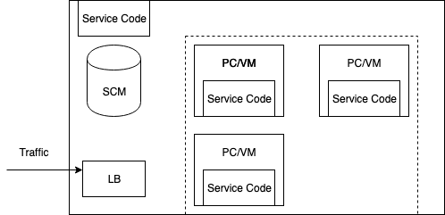
Orchestrators
Manage a cluster’s (set of PC/VMs) lifecycle, networking, health, upgrades, scaling & deploys/runs service code

Slide 9
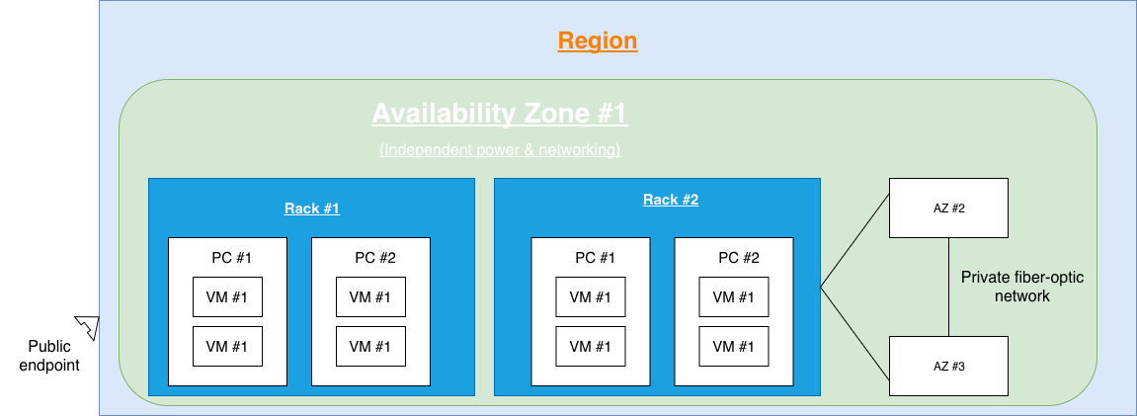

Regions, availability zones & fault domain
A fault domain is a unit of failure
Hierarchy: Planet/Region/Availability Zone/Rack/PC/VM
Intra-service communication: More fault tolerance = higher latency

Slide 10
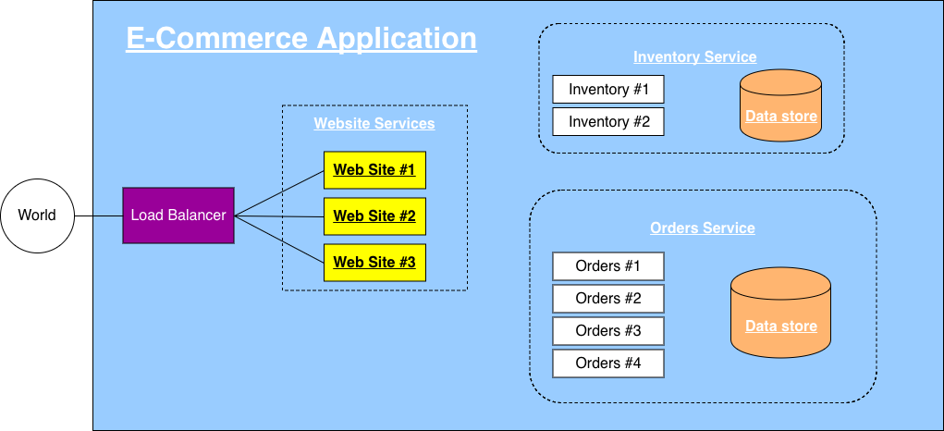
Distributed Cloud Apps - Microservices
Notes:
Microservice. – has his own datastore and only it has access to it, so no other service will brake the schema

Slide 11


Reasons to split monolithic app to microservices
Scale Independently (Balance cost with speed)
Different Technology Stacks

Slide 12
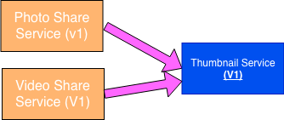
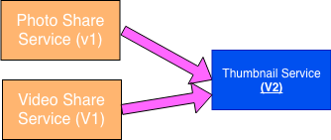
Reasons to split monolithic app to microservices
2+ Clients (Clients adopt new features at will)

Slide 13
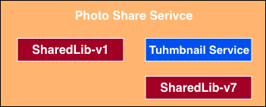
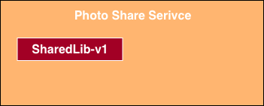
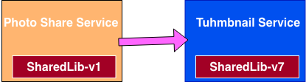
Reasons to split monolithic app to microservices
Conflicting Dependencies

Slide 14
Microservices architecture benefits myths
Microservices offer small, easy-to-understand/manage code bases
A monolith can use OOP & libraries
Library changes cause build failures (not runtime)
Failing service doesn’t impact other services
Many services require dependencies to be fully functional
Hard to write/test code that gracefully recovers when dependency fails
We run multiple service instances so there is no “failure”
A monolith is up/down completely

Slide 15
Microservices architecture benefits myths
Many promoted benefits are really about forces discipline
A microservices architecture is not required

Slide 16
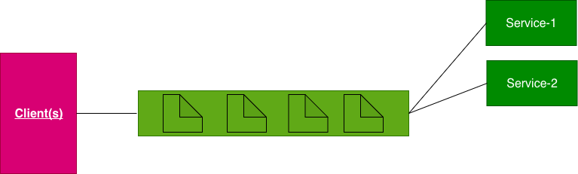
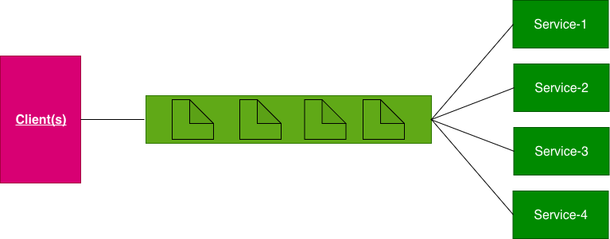
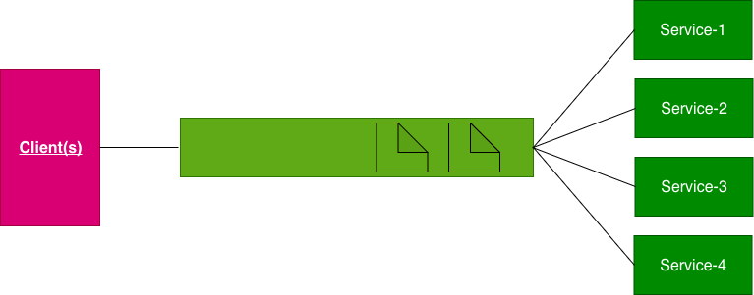


Auto Scaling
Periodically check queue length/resource usage
If growing -> scale up; if shrinking -> scale down

Slide 17
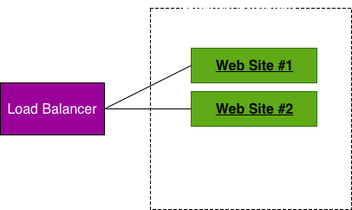
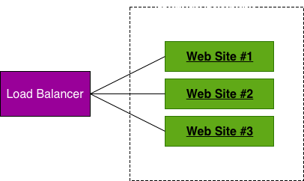
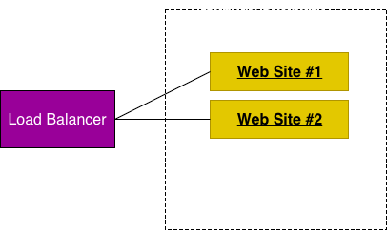
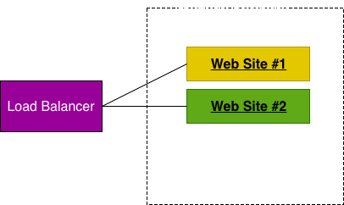
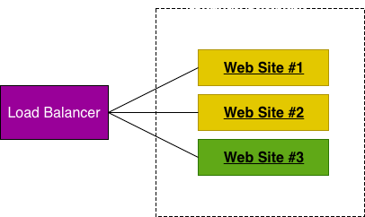
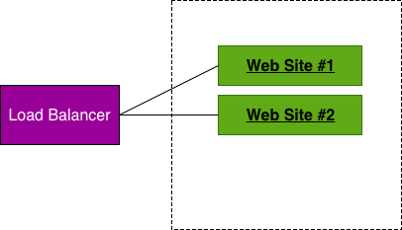
Auto Scaling
Periodically check queue length/resource usage
If growing -> scale up; if shrinking -> scale down

Slide 18
Auto Scaling
Scheduled (day/night, weekdays/weekend/holidays)
You’ re predicting load based on what you expect
Potentially dangerous as actual load may be different than predicted

Slide 19
12-factor services
Single root repos; don’t share code with another service
Deploy dependent libs with service
No config in code; read from environment variables
Handle unresponsive service dependencies robustly
Strictly separate build, release & run steps
Builds a version of the code repo & gathers dependencies
Combines build with config -> Release Id (immutable)
Runs service in execution environment

Slide 20
12-factor services
Service is stateless processes & shares nothing
Service listens on ports; avoid (web) hosts
Use processes for isolation; multiple for concurrency
Processes can crash/be killed quickly & start fast
Keep dev, staging & prod environments similar
Log to stdout (dev=console; prod=file & archive it)
Deploy & run admin tasks (scripts) as processes

Slide 21
Containers
A container image is immutable & defines a version of a single service with its dependencies (runtimes, etc.)
Use same container image everywhere: dev, test , staging, production
A container runs an image in an isolated environment.
Multiple containers (services) can run side-by-side within a single PC/VM

Slide 22
Containers
PC/VM
Container Image
svc-A v1
Container Image
svc-B v3
Container Image
svc-A v1
Svc-A v1
Svc-B v1
Svc-A v3
Container: svc-A v1
Lib-L v2
Lib-L v8
Lib-L v10
Lib-L v4
Runtime. v5
Runtime. v6
Runtime. v8

Slide 23
The 12 factors are all about…
Services should be simple to build, test & deploy
Services should be lightweight
Few dependencies, run fast & use less RAM
Services should give reproducible results on developer PC as well as test, staging & production clouds

Slide 24
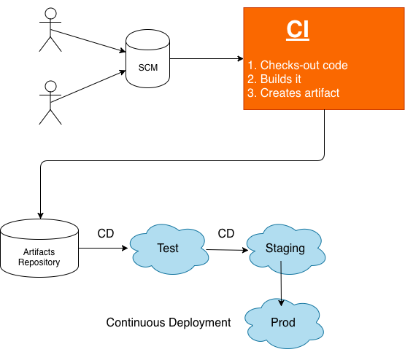
CI: Continues Integration CD: Continues Delivery & Deployment

Slide 25
CI: Continues Integration CD: Continues Delivery & Deployment
Modern DevOps is all about automation; any failures are sent back to developers & stops further progress

Slide 26
API Versioning
Is an illusion; you must always be backward compatible
You’re really always adding new APIs & stating that latest version is preferred
The required “version” indicated which API to call
http://api.bobo.com/v1/products/users
http://api.bobo.com/products/users?api-version=1
http://api.bobo.com/products/users?api-version=2016-12-07
Add new API when changing manadatory parameters, payload format, error codes (fault contract), or behavior

